Slide 1

Customer segmentation & Next item prediction
Priyanka Naidu
Graduate Data Scientist

Slide 2
Agenda:
Business problem definition
Data process design
Deliver
Summary and Next steps

Slide 3
Agenda:
Business problem definition
Data process design
Deliver
Summary and Next steps

Slide 4
Problem Statement?
Retail business is one of the huge fields where we can apply data science and machine learning.
We as retail business owners, use transaction data to identify and understand customer’s data in all aspects.
For instance, to increase sales of our store, we need to explore all possible ways like creating promotions, applying discounts on items, etc.
So, to know patterns, we look for some techniques like customer segmentation, market basket analysis.

Slide 5
The business question:
”How can we increase sales and customer base and how much difference in revenue can be observed?”

Slide 6
The data question:
“What models can be chosen to increase sales? Why do we think those are accurate models for our selected tasks? “

Slide 7
Dataset information:
Domain: Retail
Stakeholder: Store owner
Data Source: UCI machine learning repository
Time period: Transactions occurring between 01/12/2009 and 09/12/2011
Customer type: Wholesalers
Item types: Gift items

Slide 8
Data attributes:
InvoiceNo: Invoice number. Nominal, uniquely assigned to each transaction.
StockCode: Product (item) code. Nominal
Description: Product (item) name. Nominal.
Quantity: The quantities of each product (item) per transaction. Numeric.
InvoiceDate: Invoice Date and time. Numeric
UnitPrice: Product price per unit. Numeric
CustomerID: uniquely assigned to each customer. Nominal
Country: Country name where customer resides. Nominal

Slide 9
Agenda:
Business problem definition
Data process design
Deliver
Summary and Next steps

Slide 10
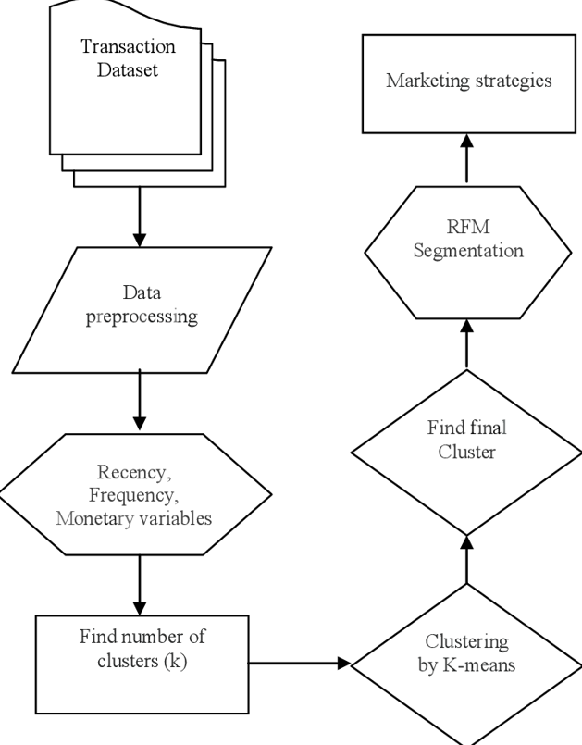
Process workflow:
After preprocessing data, used ‘InvoiceDate’ and ‘Sales’ features to find RFM values.
Elbow method is used to find clusters
Then divided data into 3 clusters

Slide 11
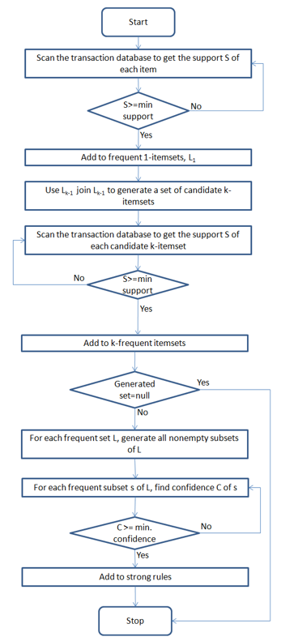
Process workflow:
A data frame called basket data which contains the count of transactional data was created.
Then, encoded data with binary values.
And filtered repeated products.
Applied ‘Apriori’ algorithm with min support ‘0.03’ and max_length ‘3’.
Finally, applied association rules with metric ‘lift’ to find the frequent pattern

Slide 12
Agenda:
Business problem definition
Data process design
Deliver
Summary and Next steps

Slide 13
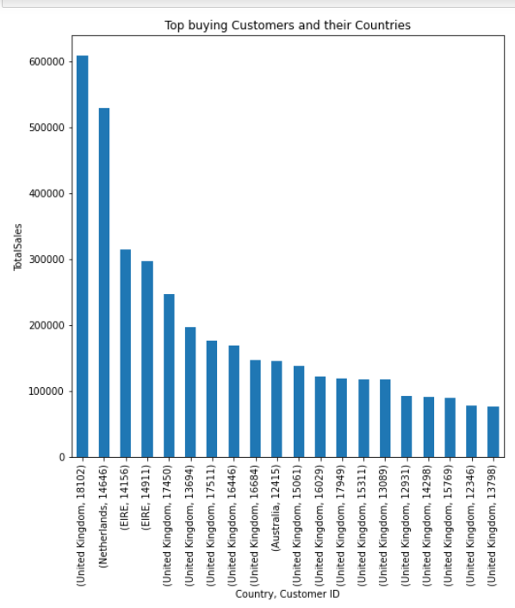
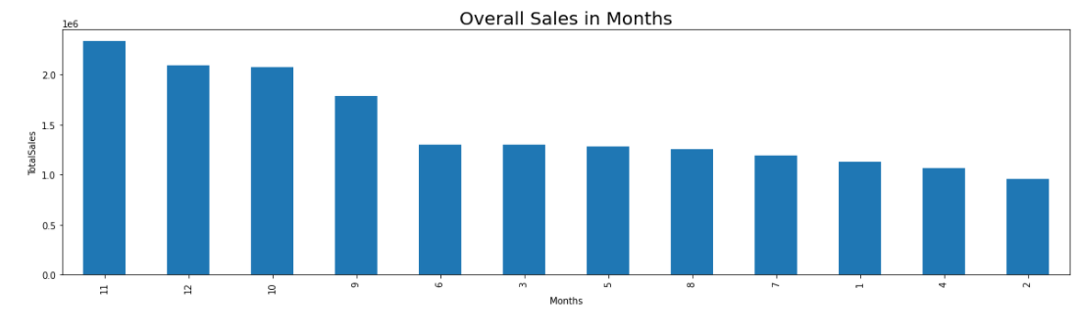
Observations:
Who are top customers?
Which month has highest transactions?

Slide 14
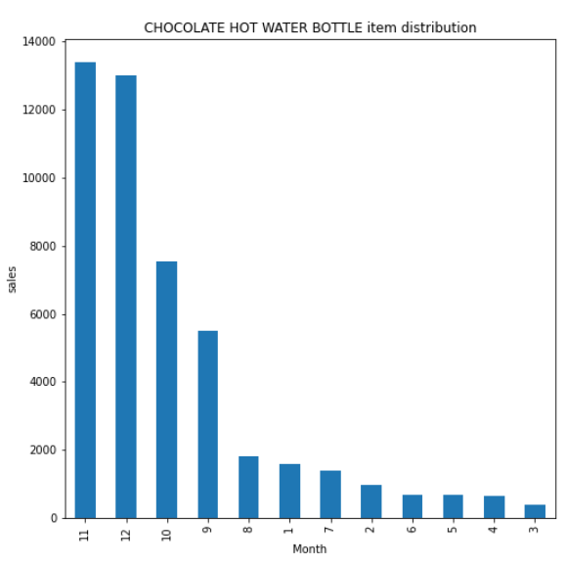
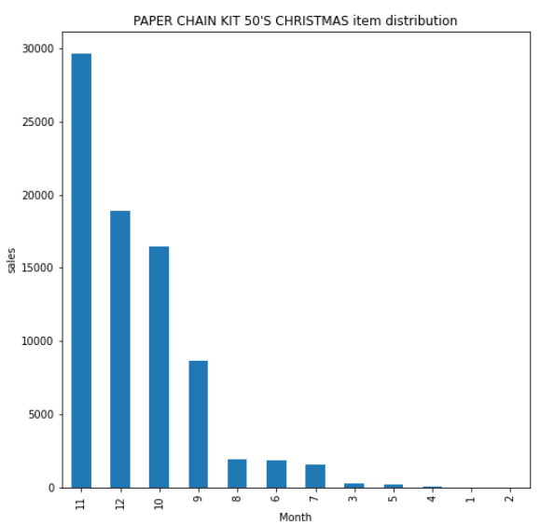
Comparing seasonal items:
Are there any products which are seasonal?

Slide 15
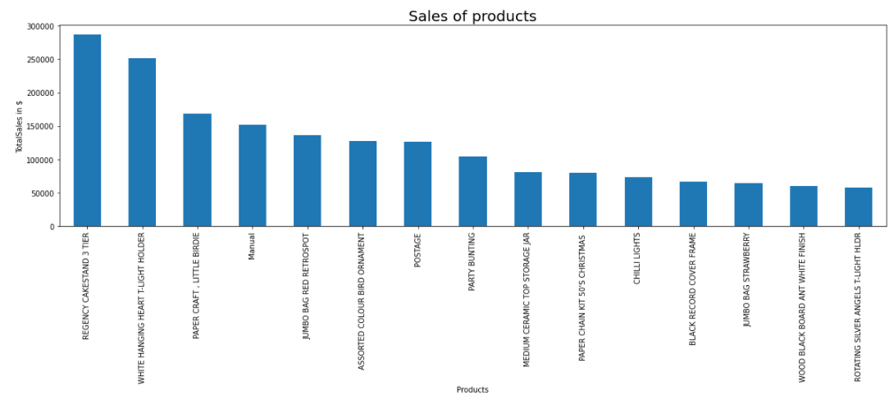
What are top revenue generating items?

Slide 16
Agenda:
Business problem definition
Data process design
Deliver
Summary and Next steps

Slide 17
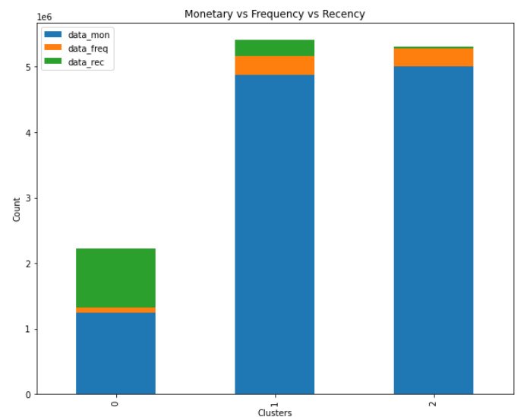
Customer segmentation Summary:
From the above bar plot, we can interpret
Monetary: 2>1>0
Frequency: 1>2>0
Recency: 0>1>2
It means:
2nd cluster is promising one
1st have frequent buyers
0th cluster is at risk and hence not promising one

Slide 18
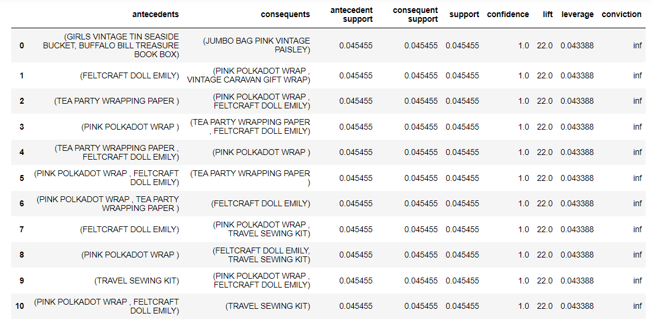
MBA Summary:
A = “GIRLS VINTAGE TIN SEASIDE BUCKET, BUFFALO BILL TREASURE BOOK BOX”
B = “JUMBO BAG PINK VINTAGE PAISLEY”
“lift” is ‘22’..
Support of these items is 0.0454% which means there are 4.54% out of total transaction that were sold together.

Slide 19
Data answer:
To divide data into segments and target specific group, used RFM analysis and K-means
For next item prediction, we have used market basket analysis which uses association rules and Apriori algorithm .
Advantages:
Powerful
Easy to implement
Limited resources

Slide 20
Business answer:
Current avg sale of least cluster which is at risk is almost 12,48,606$.
So, if we can target this group, we have possibility to increase sale by almost 8%.
This can be done by applying discounts, promotions, suggestions as discussed earlier.

Slide 21
Next steps:
We can use other complex ways to analyze data (clustering, regression, Neural Networks, Random Forests, SVM, etc.).
To get good results and interpret data, we have many approaches, but challenges associated are:
Difficult to tune
Bit of data prep and feature engineering is needed.
Hence, as these are powerful and hard to implement, didn’t implement now. But can consider this step later.

Slide 22
Thank you!

